Slide 1

Data Analytics Portfolio
Project case studies
By Brian Avila

Slide 2

Table of Contents
Skillsets
Influenza Medical Staffing Plan
Analysis
Visualizations
Conclusion
Key Takeaways
Project Links
Contact info

Slide 3

Skillsets
My Skillsets
Data Analysis
Tableau Visualizations
SQL Relational Databases
PostgreSQL
Python
MS Excel (Pivot Tables, VLOOKUP)
Time Series Analysis and
Forecasting
Statistical Analysis
Data Transformation and integration

Slide 4

Influenza medical staffing plan
Let’s Dive In
GOAL: To help a medical staffing agency that provides temporary workers to clinics and hospitals on an as-needed basis. The analysis will help plan for influenza season, a time when additional staff are in high demand. The final results will examine trends in influenza and how they can be used to proactively plan for staffing needs across the country.

Slide 5


Analysis
Data Sets
Tools
Process
Listed the data questions to be answered.
Designed a Data Research Project
Formulated a research hypothesis
Sourced the Right Data
Created a data profile
Implemented data quality measures
Integrated data from 2 sources into 1.
Conducted Statistical Analysis by calculating variance and standard deviation
Formulated a statistical hypothesis
Created an interim report
Influenza deaths by geography, time, age, and gender
Source: CDC
Download Data Set
2. Population data by geography
Source: US Census Bureau
Download Data Set
Microsoft Excel

Slide 6
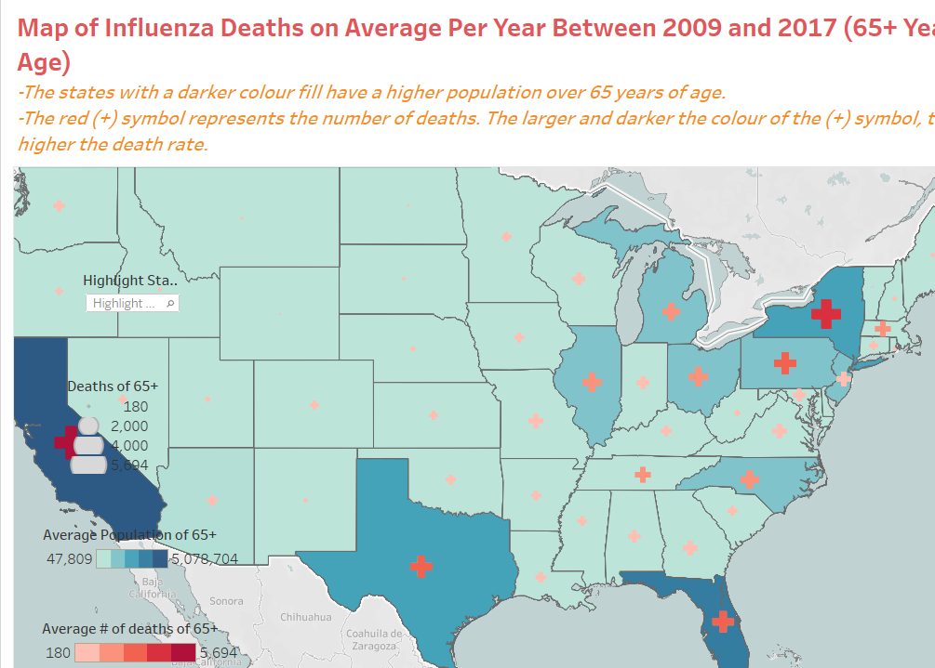
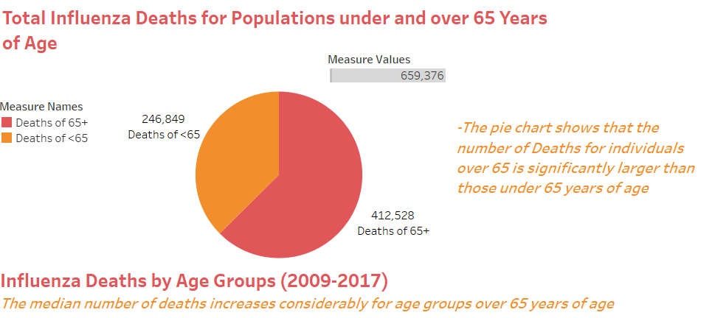
Visualizations & Storytelling

Slide 7
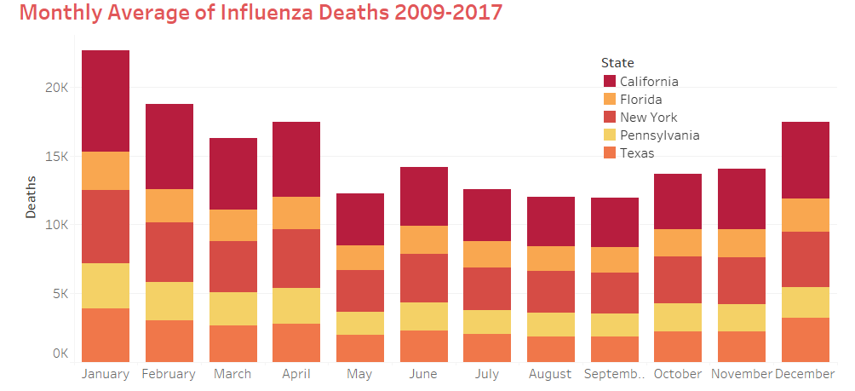
Conclusion
The analysis conducted revealed that Influenza poses a threat to populations over 65 years of age.
The states more populous with this vulnerable age group are California, New York, Texas, Pennsylvania, and Florida.
The months the Influenza Virus is more prominent are December, January, February, March, and April.
The states of California, New York, Texas, Florida, and Pennsylvania have historically high mortality due to Influenza.
It was recommended that medical staff should be sent to these hotspots during the peak months of December through April.
Project link

Slide 8
Key Takeaways
Reflecting on the outcomes of the influenza season staffing analysis project:
There were several key insights and recommendations that emerged. The process involved a comprehensive examination of influenza trends, vulnerable demographics, and historical data, leading to actionable strategies for the medical staffing agency. It reinforced the significance of basing decisions on data-driven insights. Leveraging historical data on influenza trends, mortality rates, and demographic distributions allowed for a targeted and informed approach to staffing allocation.
Approach Enhancement for the Next Project:
As I transition to the next project, there are opportunities to enhance my approach and take it to the next level. To elevate the analysis, I’m considering incorporating advanced analytics and machine learning models. These technologies can provide more accurate predictions of influenza trends, allowing for even more precise and timely staffing decisions.

Slide 9




THANK YOU
Project links
CONTACT INFORMATION
(25) Brian Avila | LinkedIn
+1 (508) 905 9144
brianavila819@gmail.com

